Slide 1

Image courtesy of NASA/GSFC

Slide 2
Climate Change and Farmer Adaptation in the Midwest
Eugene S. Takle
Professor
Department of Agronomy
Department of Geological and Atmospheric Science
Director, Climate Science Program
Iowa State University
Ames, IA 50011
World Climates
Agronomy 406
Iowa State University
14 November 2012

Slide 3
Outline
Brief review of future climate scenarios as projected by climate models
Projected changes in US climate
Changes of importance to agriculture
Recent trends in Iowa’s climate and producer adaptation
What about the future: droughts or floods?

Slide 4
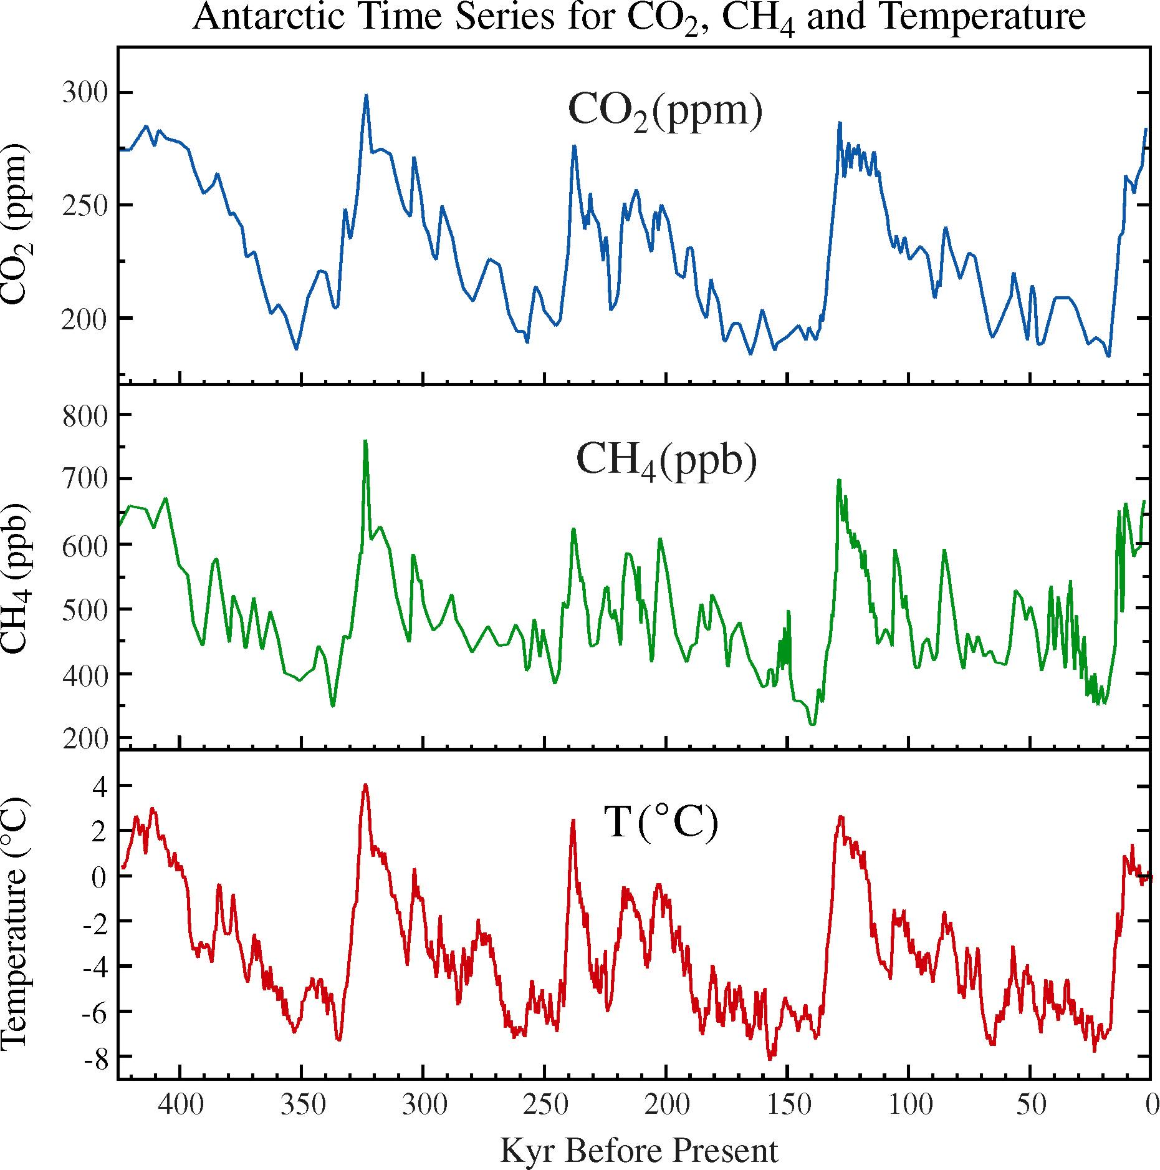
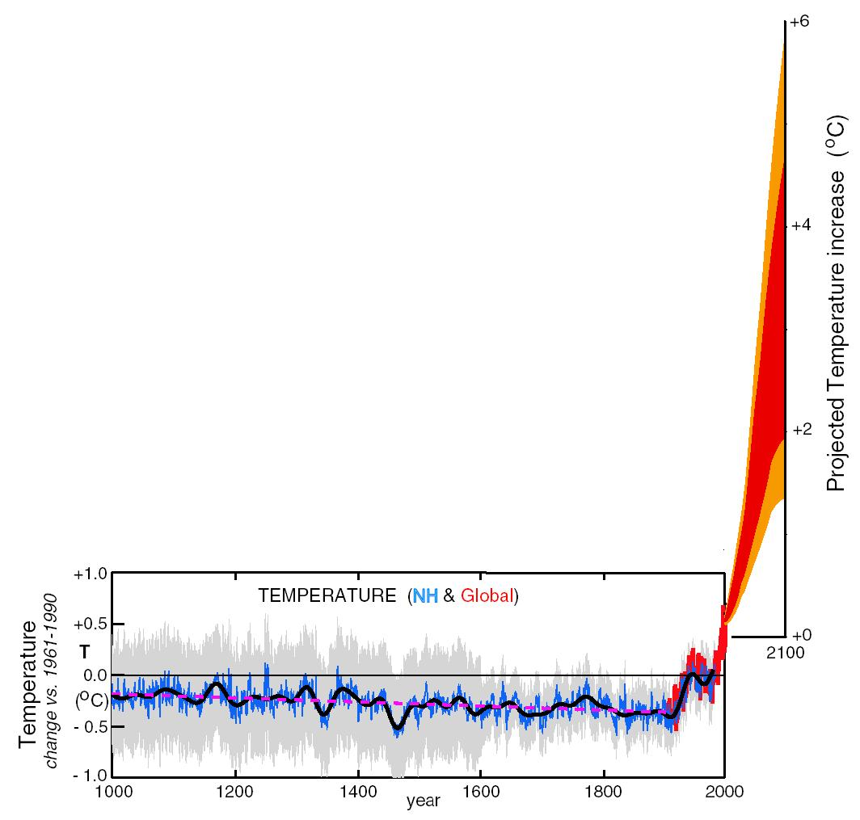
What can we expect in the future?
Don Wuebbles

Slide 5
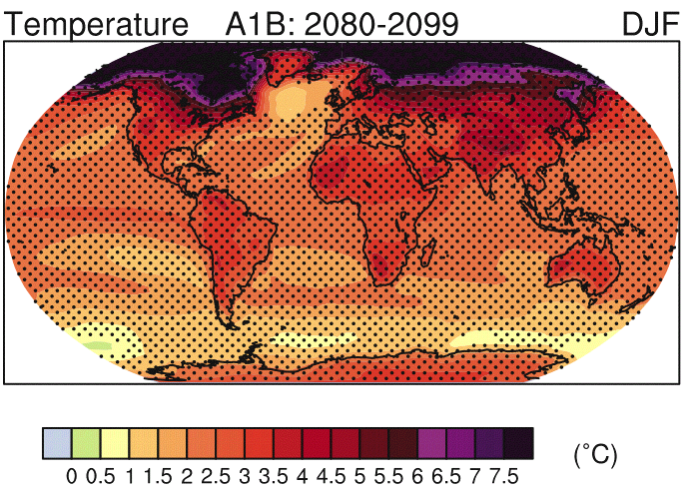
IPCC 2007

Slide 6
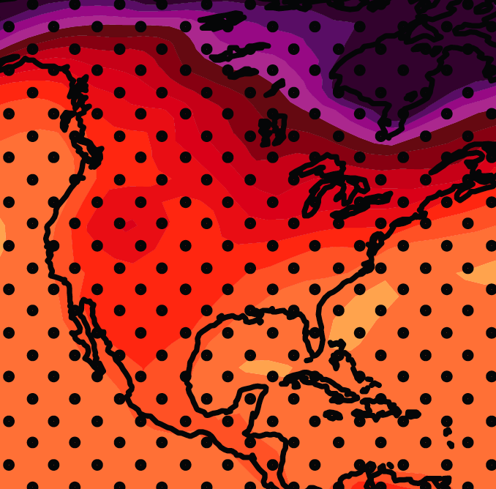
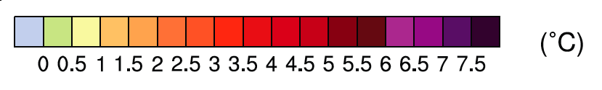
December-January-February Temperature Change
7.2ºF
6.3ºF
A1B Emission Scenario
2080-2099 minus1980-1999

Slide 7
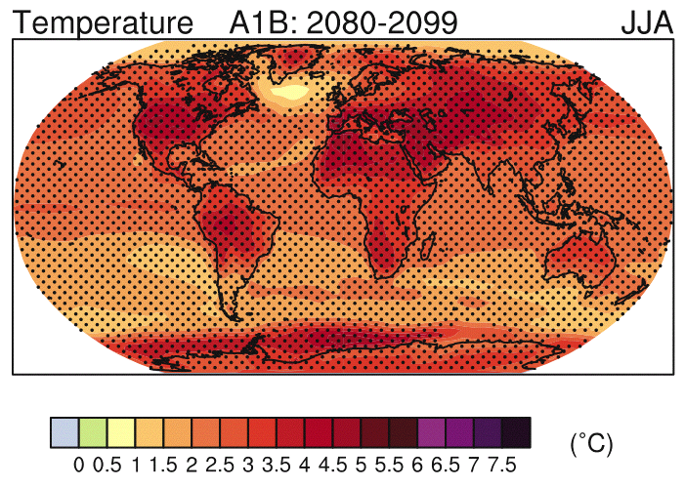
IPCC 2007

Slide 8
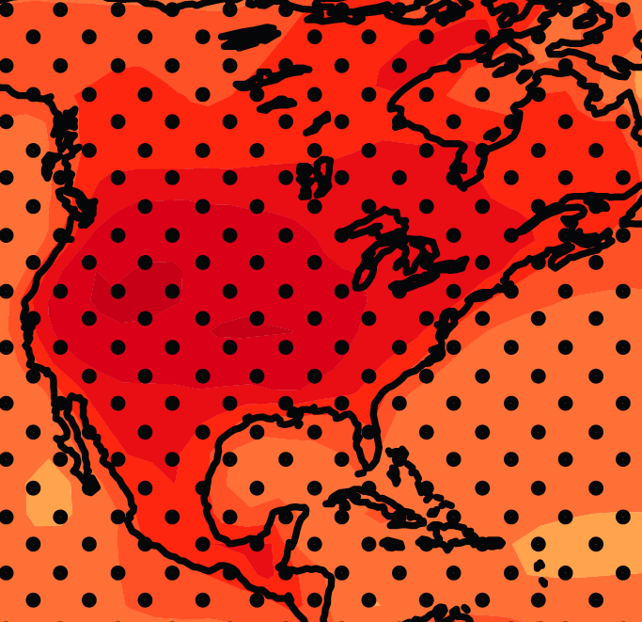
June-July-August Temperature Change
4.5ºF
5.4ºF
A1B Emission Scenario
2080-2099 minus1980-1999

Slide 9
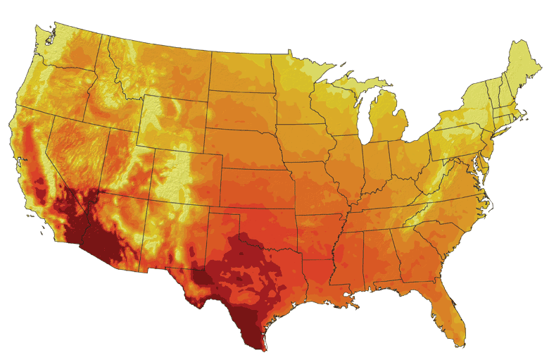
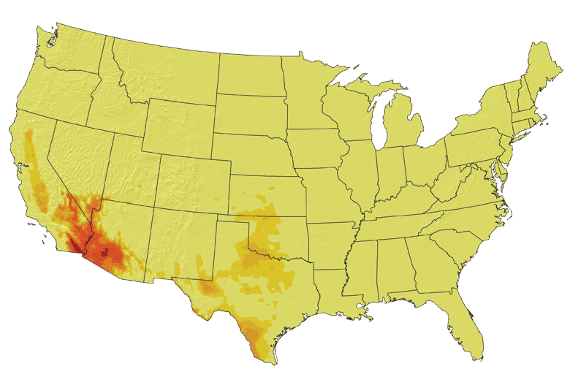
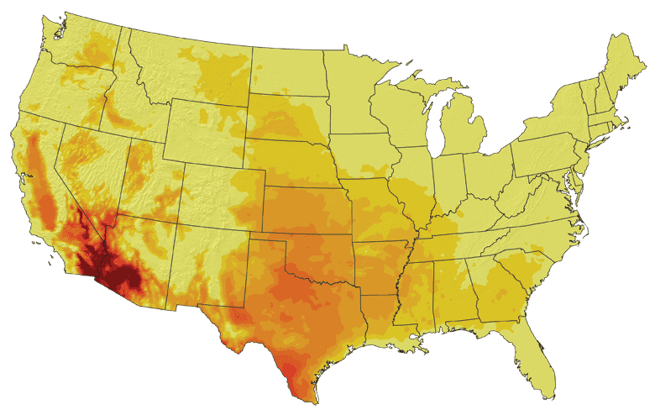
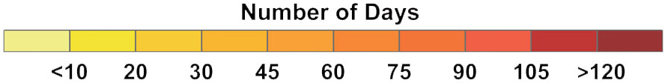
Increases in very high temperatures will have
wide-ranging effects
Higher Emissions Scenario, 2080-2099
Number of Days Over 100ºF
Recent Past, 1961-1979
Average:
30-60 days
Lower Emissions Scenario, 2080-2099
Average:
10-20 days
Don Wuebbles

Slide 10
Increases in very high temperatures will have
wide-ranging effects
Higher Emissions Scenario, 2080-2099
Number of Days Over 100ºF
Recent Past, 1961-1979
Average:
30-60 days
Current Des Moines average is < 1.4 days per year over 100ºF
Lower Emissions Scenario, 2080-2099
Average:
10-20 days
Don Wuebbles

Slide 11
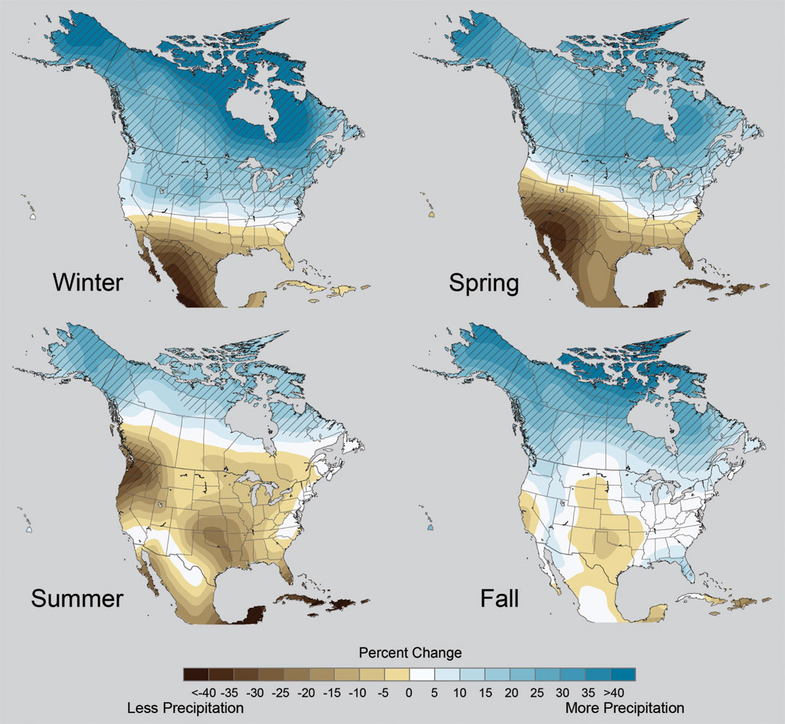
Projected Change in Precipitation: 2081-2099
Midwest: Increasing winter and spring precipitation, with drier summers
More frequent and intense periods of heavy rainfall
Unstippled regions indicate reduced confidence
CAUTION: High uncertainty
Relative to 1960-1990
NOTE: Scale Reversed

Slide 12
Extreme weather events become more common
Events now considered rare will become commonplace.
Heat waves will likely become longer and more severe
Droughts are likely to become more frequent and severe in some regions
Likely increase in severe thunderstorms (and perhaps in tornadoes).
Winter storm tracks are shifting northward and the strongest storms are likely to become stronger and more frequent.
Don Wuebbles
Notes:
Shown here is the frequency at the end of the century of what we consider now to be a 20 year heat wave. Instead of once every 20 years, these temperatures would be experienced every other year or so over most of the continental US in this business as usual scenario.

Slide 13
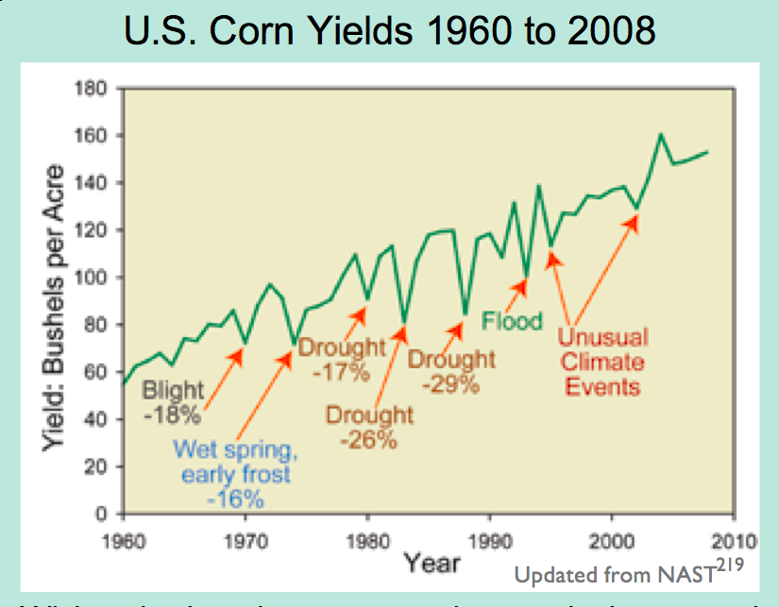
Extreme Events are Usually Detrimental to Corn Production

Slide 14
Key Messages from
The 2008 USGCRP
Synthesis and
Assessment
Product 4.3
(now being updated by the National Climate Assessment)

Slide 15
Projected Changes to US Agriculture
Climate changes are already affecting U.S. water resources, agriculture, land resources, and biodiversity
Climate change will continue to have significant effects on these resources over the next few decades and beyond
The life cycle of grain and oilseed crops will likely progress more rapidly
Crops will increasingly begin to experience failure
The marketable yield of many horticultural crops – e.g., tomatoes, onions, fruits – is more sensitive to climate change than grain and oilseed crops.
Key Messages from the 2008 Agriculture Chapter of USGCRP SAP 4.3

Slide 16
Percent Changes in Crop Yield with
Projected Changes in Annual Mean Temperature
(not water or nutrient limited)
California Central Valley
Lee, J., S. DeGryze, and J. Six. 2011. Effect of climate change on field crop production in the California’s Central Valley. Climatic Change. 109(Suppl):S335-S353

Slide 17
Projected Yield Changes for California Crops
Simulations using the DAYCENT model while ensuring water supplies and nutrients were maintained at adequate levels under low (B1) and medium-high (A2) emissions scenarios.
Lee, J., S. DeGryze, and J. Six. 2011. Effect of climate change on field crop production in the California’s Central Valley. Climatic Change. 109(Suppl):S335-S353

Slide 18
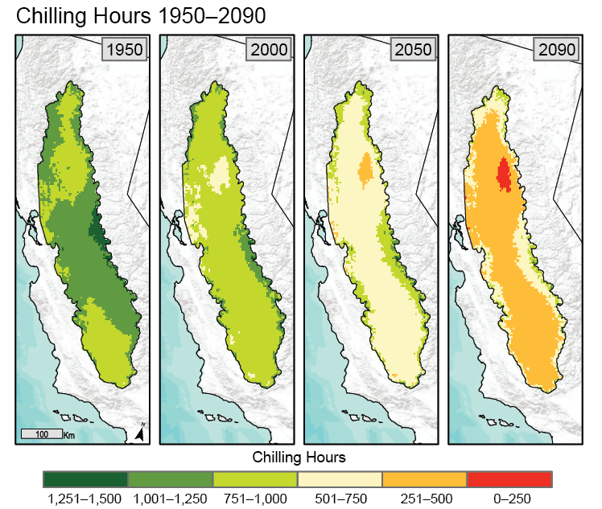
Changes in Climate Relevant to Plant Stress
A2 Climate scenario
Chilling hours for fruit production
Number of chilling hours is projected to rapidly decrease over the next 100 years.
Trees and grapes differ in their chilling requirements:
grapes: 90
peaches 225
apples 400
cherries 900

Slide 19
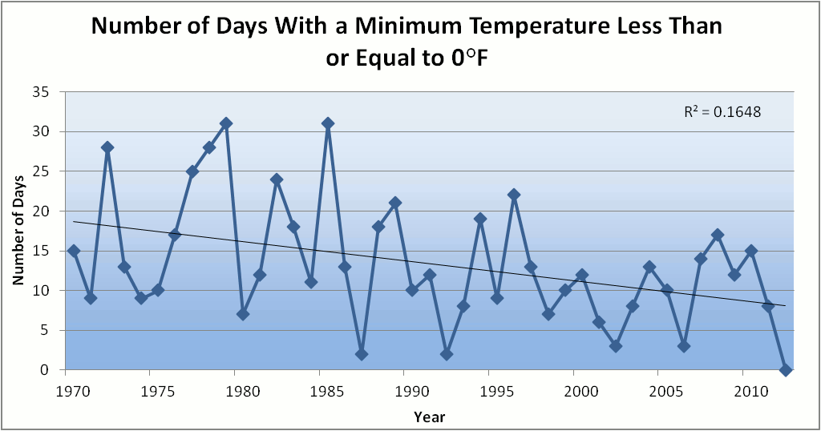
Des Moines Airport Data
Caution: Not corrected for urban heat island effects

Slide 20
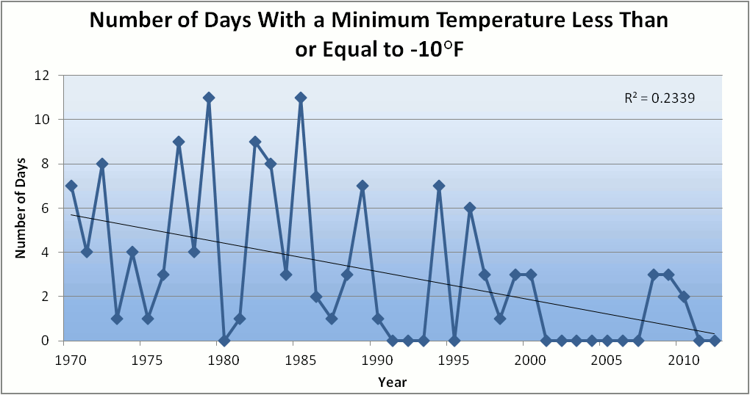
Des Moines Airport Data
Caution: Not corrected for urban heat island effects

Slide 21
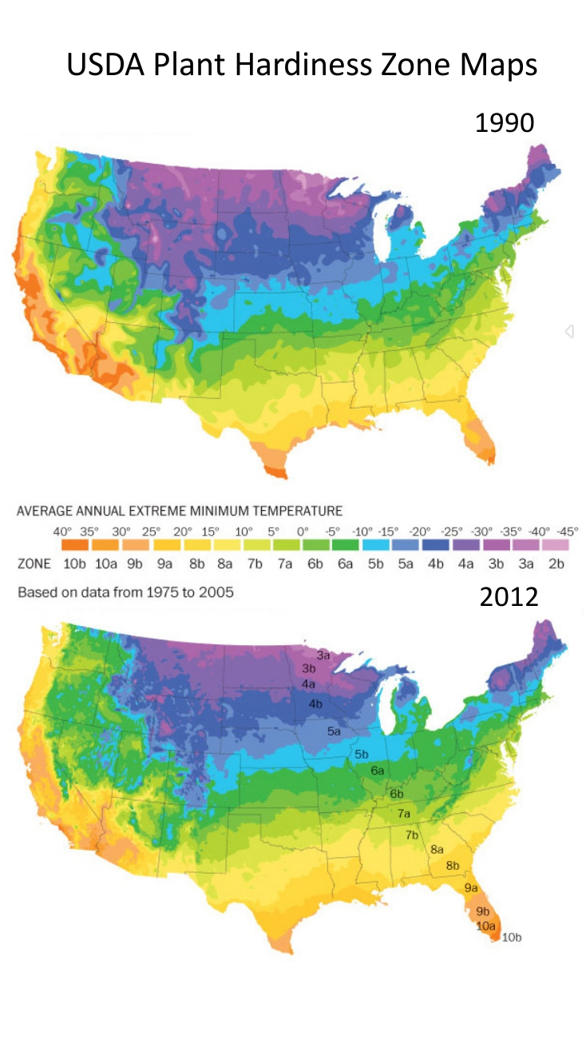
Winter Temperatures are Rising, Fewer Extreme Cold Events
Des Moines Data
Des Moines Data

Slide 22
Iowa State-Wide Average Data

Slide 23
Des Moines Airport Data
1983: 13
1988: 10
1977: 8
1974: 7

Slide 24
Des Moines Airport Data
1983: 13
1988: 10
1977: 8
1974: 7
6 days ≥ 100ºF in 23 years

Slide 25
Des Moines Airport Data
1983: 13
8 days in 2012
1988: 10
1977: 8
1974: 7
6 days ≥ 100ºF in 23 years

Slide 26
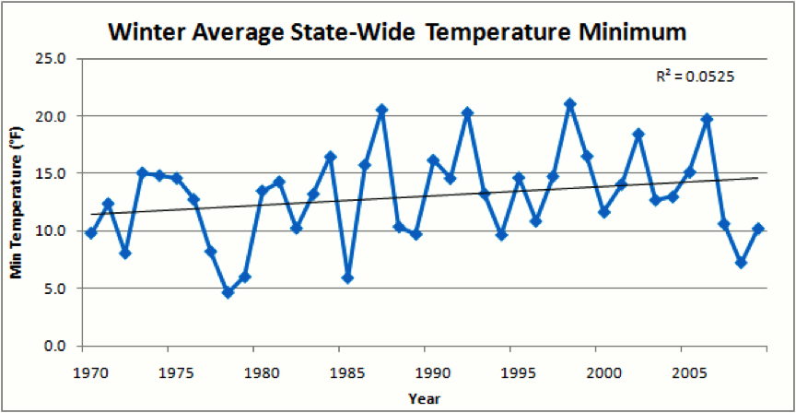
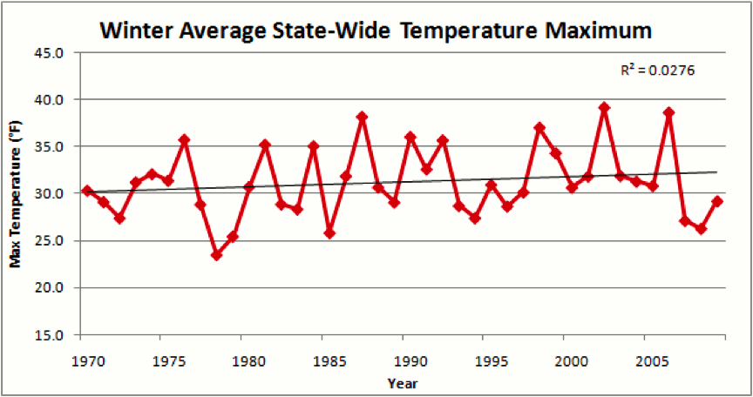
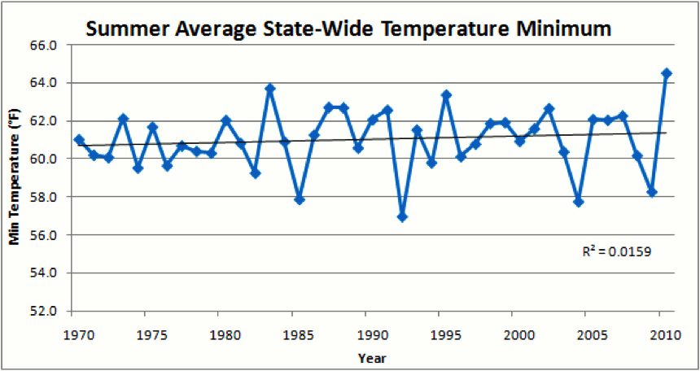
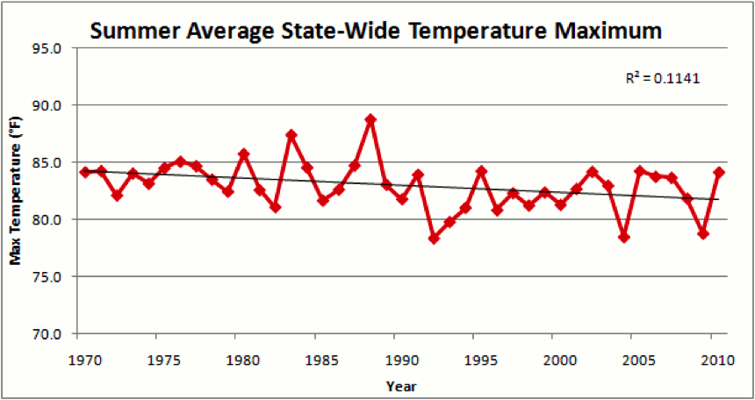

Slide 28
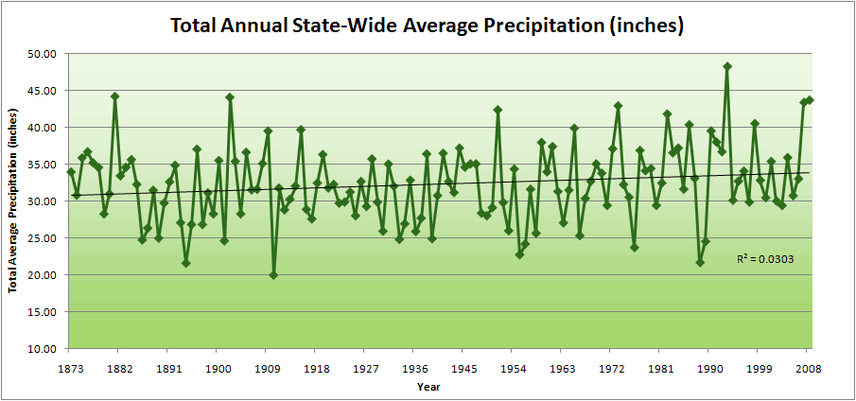
Iowa State-Wide Average Data
34.0”
10% increase
30.8”

Slide 29
Iowa State-Wide Average Data
Totals above 40”
2 years
34.0”
10% increase
30.8”

Slide 30
Iowa State-Wide Average Data
Totals above 40”
2 years
8 years
34.0”
10% increase
30.8”

Slide 31
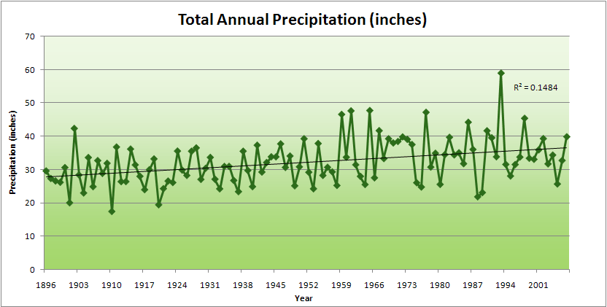
Cedar Rapids Data

Slide 32
Cedar Rapids Data
28.0”
32% increase
37.0”

Slide 33
Cedar Rapids Data
Years with more than 40 inches
11
1
28.0”
32% increase
37.0”

Slide 34
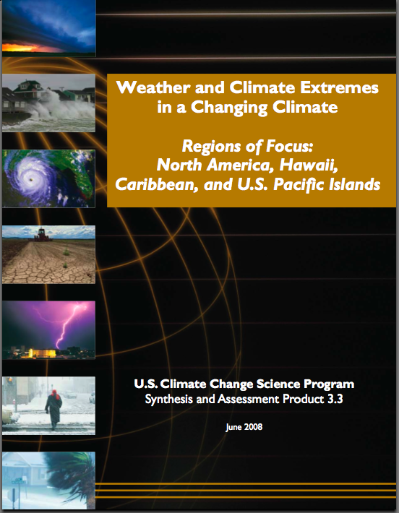
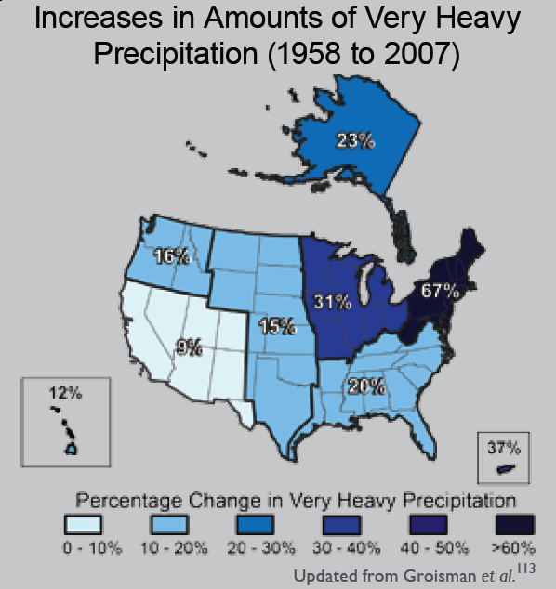
“One of the clearest trends in the United States observational record is an increasing frequency and intensity of heavy precipitation events… Over the last century there was a 50% increase in the frequency of days with precipitation over 101.6 mm (four inches) in the upper midwestern U.S.; this trend is statistically significant “
Karl, T. R., J. M. Melillo, and T. C. Peterson, (eds.), 2009: Global Climate Change Impacts in the United States. Cambridge University Press, 2009, 196pp.

Slide 35
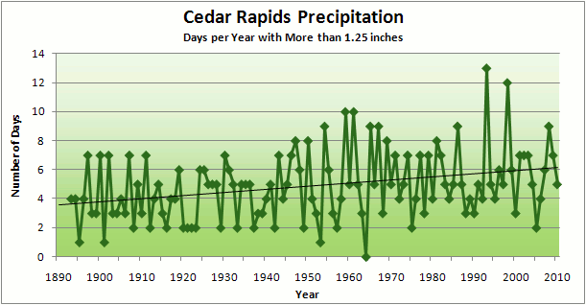
Cedar Rapids Data
3.6 days
67% increase
6.0 days

Slide 36
Cedar Rapids Data
Number of Years with More than 8 Occurrences
0
9
3.6 days
67% increase
6.0 days

Slide 38
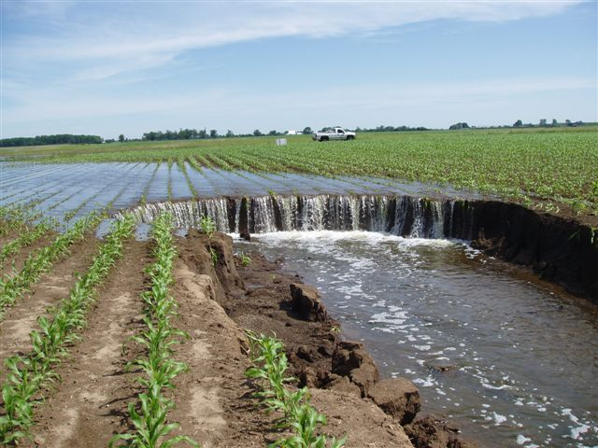
Photo courtesy of RM Cruse

Slide 39
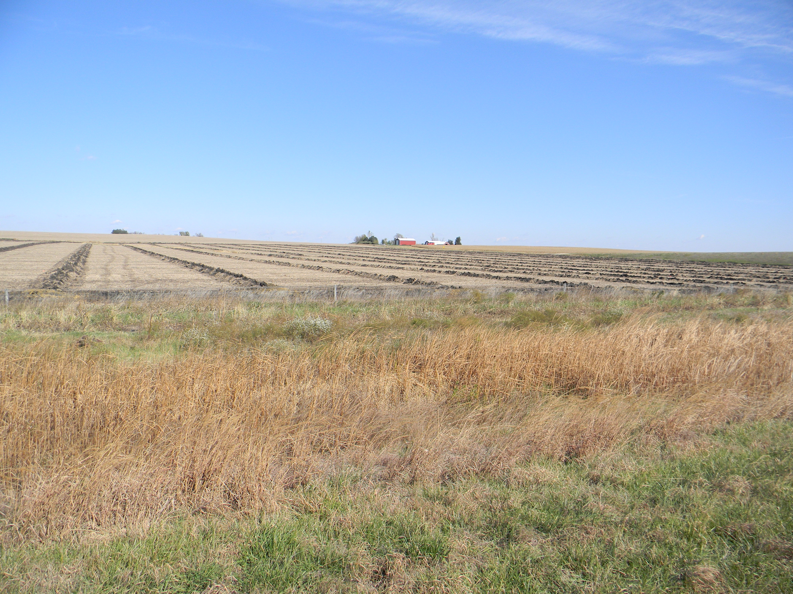

Slide 40
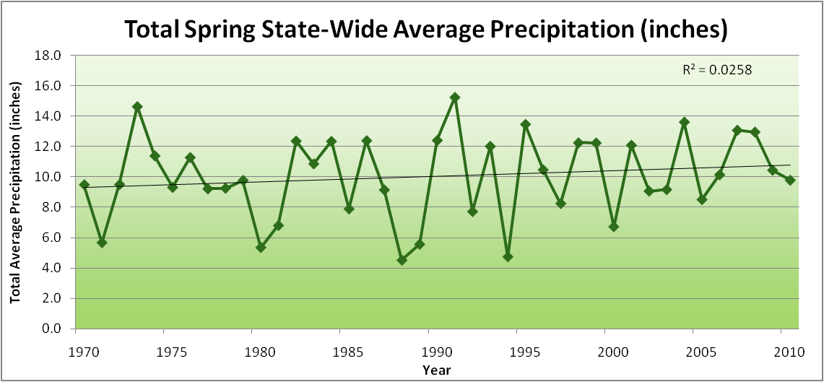
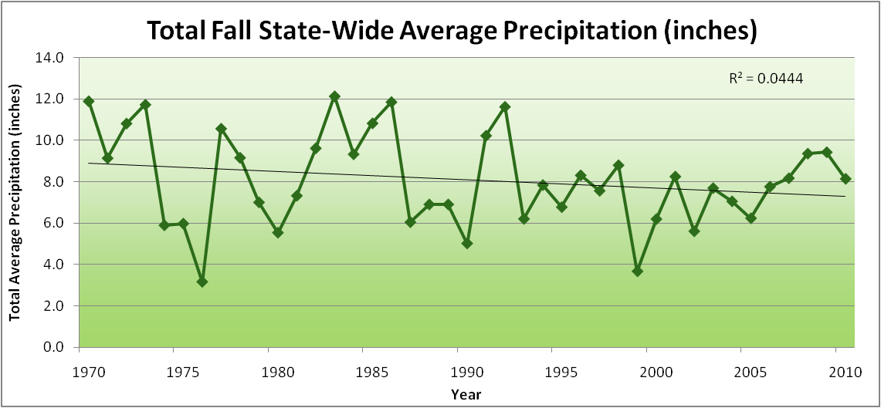
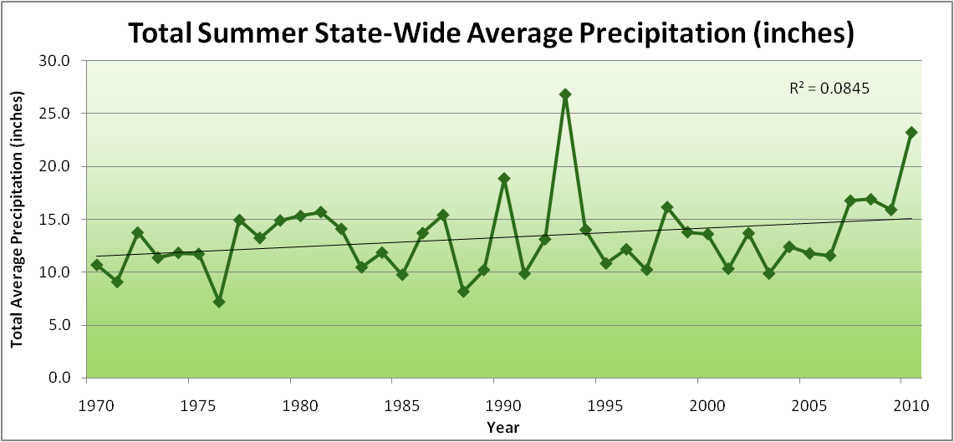
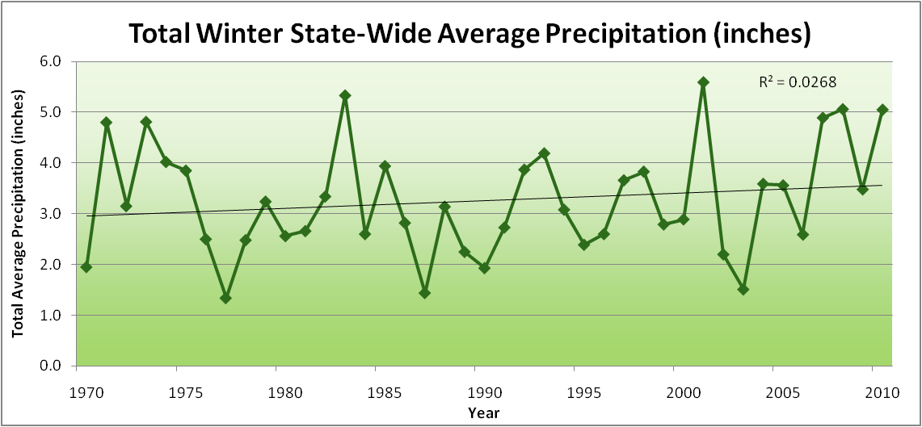
Amplification of the Seasonality of Precipitation
Spring
Fall
Summer
Winter

Slide 41
Amplification of the Seasonality of Precipitation
Spring
Fall
Summer
Winter

Slide 42
Amplification of the Seasonality of Precipitation
Spring
Fall
21.2 => 25.3 inches (22% increase)
12.1 => 10.5 inches (13% decrease)
Summer
Winter

Slide 43
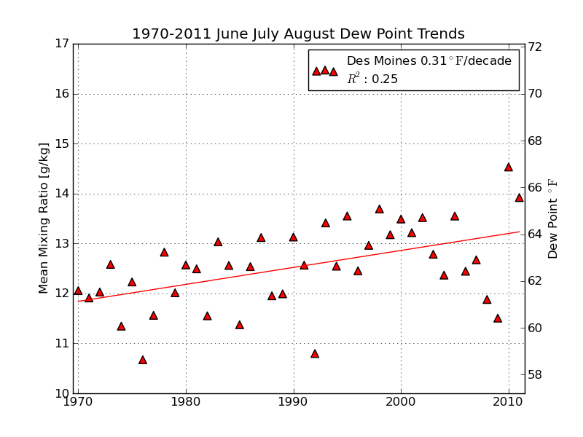
Mean Summer (JJA) Dew-Point Temperatures for Des Moines, IA
Rise of 3ºF in 42 years
12% rise in water content in 42 years

Slide 44
Iowa Agricultural Producers are Adapting to Climate Change:
Longer growing season: plant earlier, plant longer season hybrids, harvest later
Wetter springs: larger machinery enables planting in smaller weather windows
More summer precipitation: higher planting densities for higher yields
Wetter springs and summers: more subsurface drainage tile is being installed, closer spacing, sloped surfaces
Fewer extreme heat events: higher planting densities, fewer pollination failures
Higher humidity: more spraying for pathogens favored by moist conditions. more problems with fall crop dry-down, wider bean heads for faster harvest due to shorter harvest period during the daytime.
Drier autumns: delay harvest to take advantage of natural dry-down conditions, thereby reducing fuel costs
HIGHER YIELDS!!
Is it genetics or climate? Likely some of each.

Slide 45
So what about droughts in the future?

Slide 46
Iowa State-Wide Average Data
Totals above 40”
2 years
8 years
34.0”
10% increase
30.8”

Slide 47
Iowa State-Wide Average Data
Totals above 40”
2 years
8 years
3 years
5 years
2012?
Totals below 25”

Slide 48
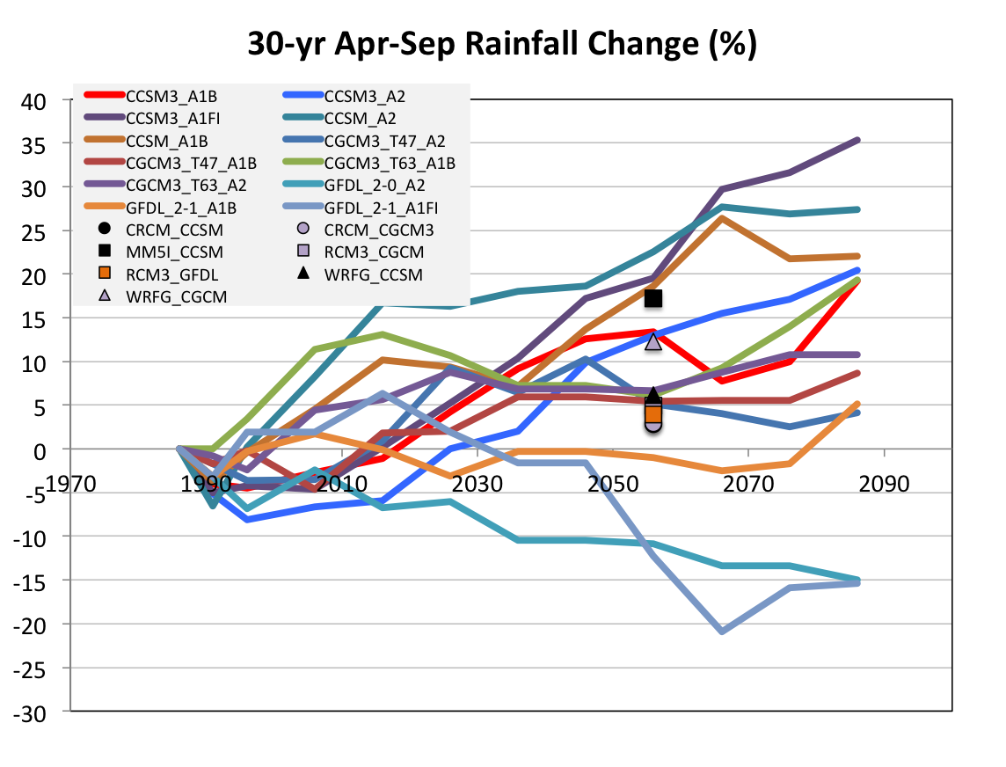
Projected Change in Growing Season Precipitation for Iowa
No change
GFDL
CJ Anderson, ISU

Slide 49
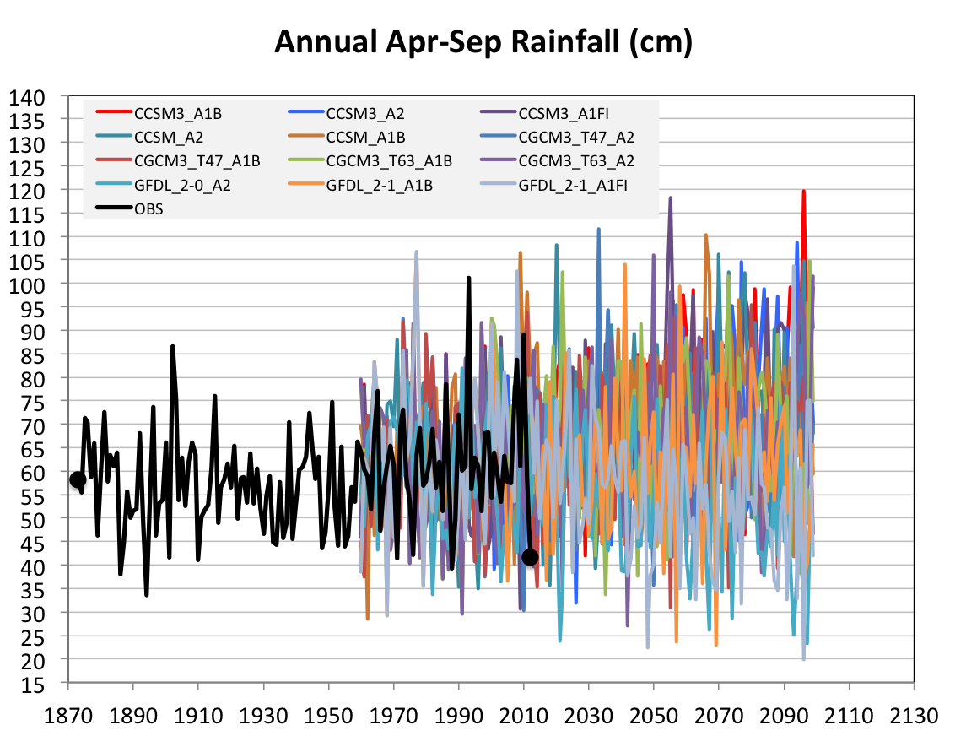
Future Variability in Growing Season Precipitation for Iowa
More extreme floods
More extreme droughts
CJ Anderson, ISU

Slide 50
Future Variability in Growing Season Precipitation for Iowa
More extreme floods
Lines drawn by eye
More extreme droughts
CJ Anderson, ISU

Slide 51
Summary
Both agricultural crops and non-agricultural plants are being affected by climate change, and as the climate changes further, yields will decline
Higher precipitation of the last 40 years has suppressed Iowa daily max temperatures in summer; dry summers in the future will unmask this underlying warming
Frequency of precipitation extremes has increased
Future projections indicate higher frequency of both floods and droughts

Slide 52
For More Information:
Climate Science Program
Iowa State University
http://climate.engineering.iastate.edu/
http://www.meteor.iastate.edu/faculty/takle/
gstakle@iastate.edu

